Slide 1
STV is based on object detection for forming a semantic model of the industrial-urban environment
Mikhail Podvalkov

Slide 2
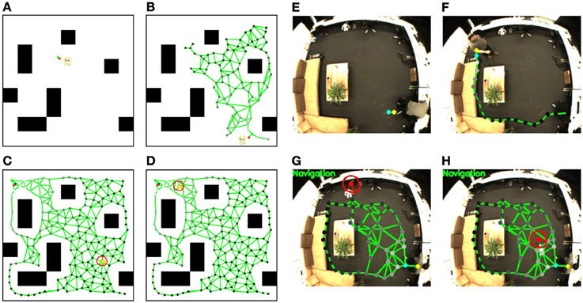
Problem Statement
Navigation in Indoor Space

Slide 3
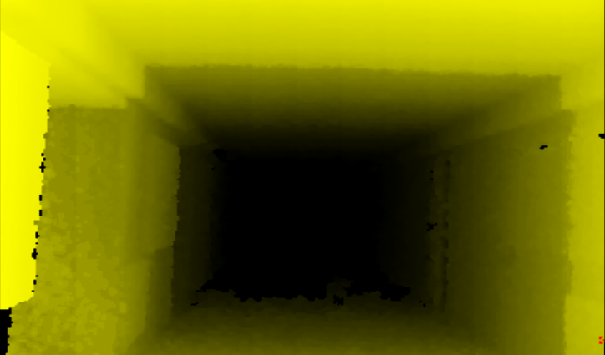
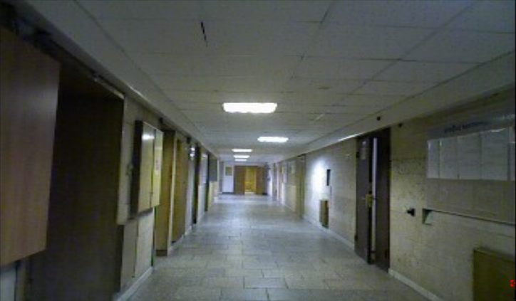
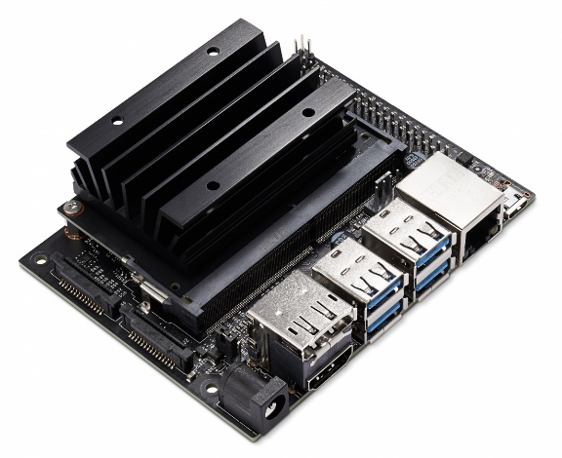
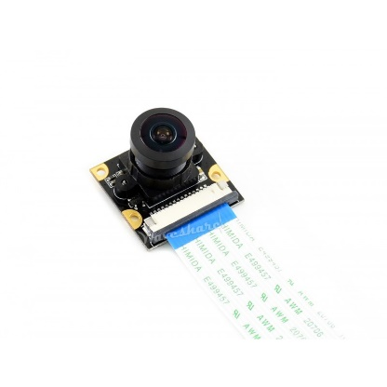
Technical Challenges
The Depth and RGB scene of Bauman’s MSTU corridor
NVIDIA Jetson Nano
IMX219-160

Slide 4
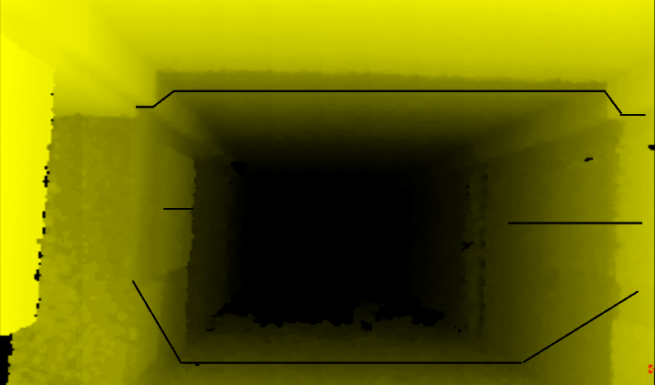
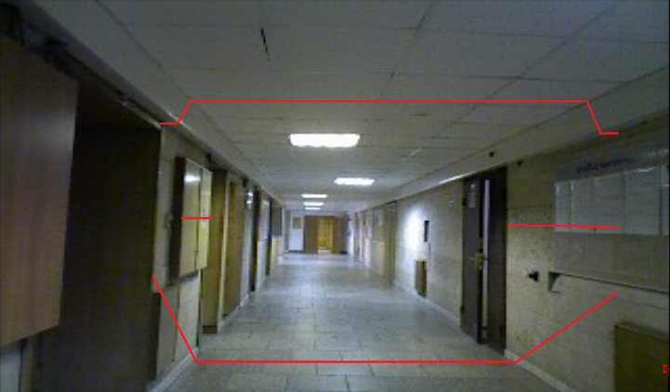
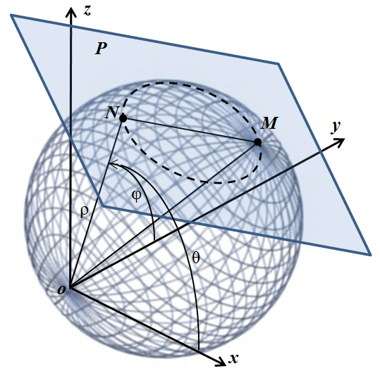
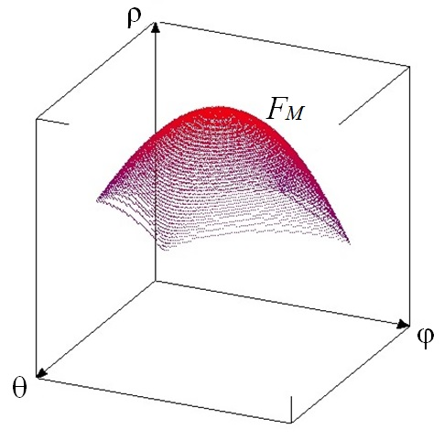
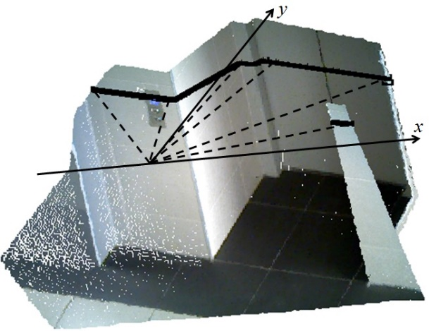
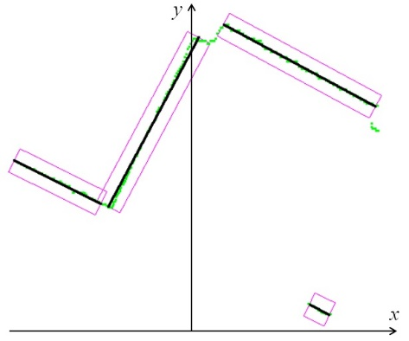
Related Work
The Depth and RGB scene with finding a geometric primitives
3D Hough transform
An example of a way to geometric primitives

Slide 5
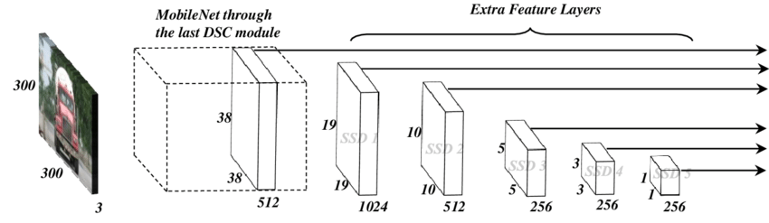
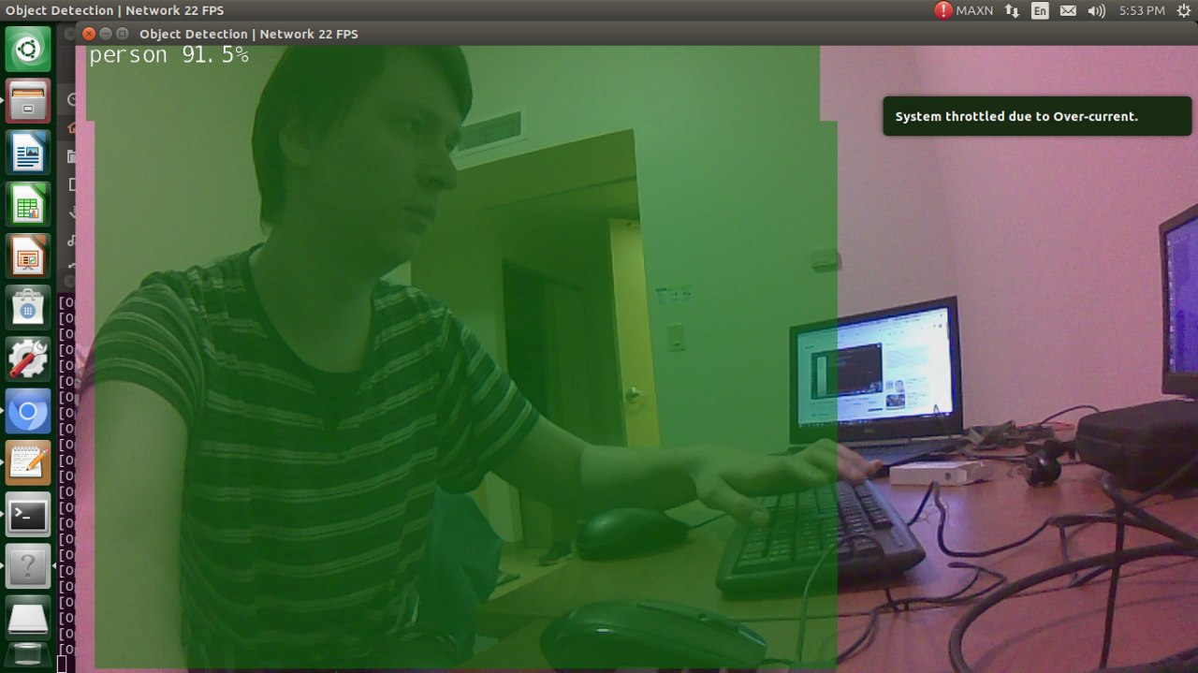
Approach and Result
SSD MobileNet Architecture
Result

Slide 6
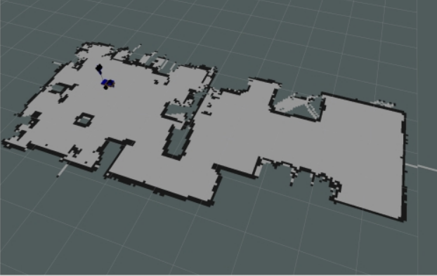
Broader Impact

